Slide 1
Make Your Escape!
Making an escape room in PowerPoint
Sharon Goza
Game2Learn, LLC

Slide 2
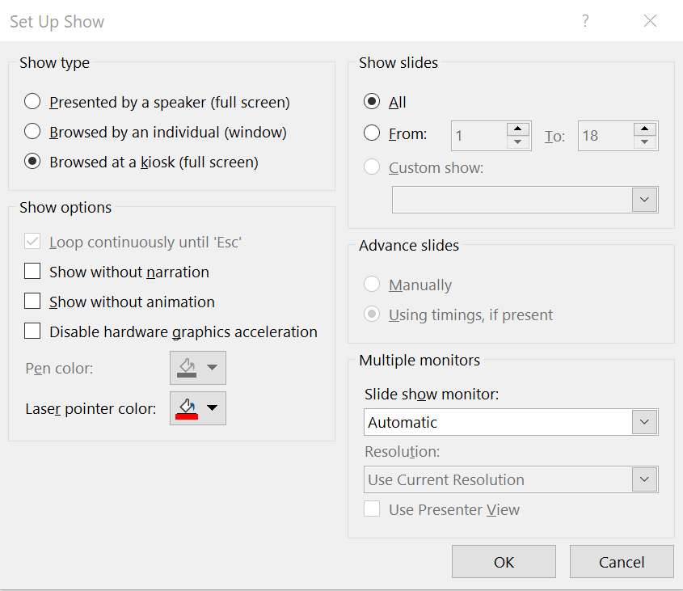
Slide Show Setup
Select Slide Show
Select Set Up Slide Show
This pops up the “Set Up Show” dialog
Select “Browsed at a kiosk” (full screen)
This will make it so that people cannot use the arrow keys when navigating through your escape room.

Slide 3
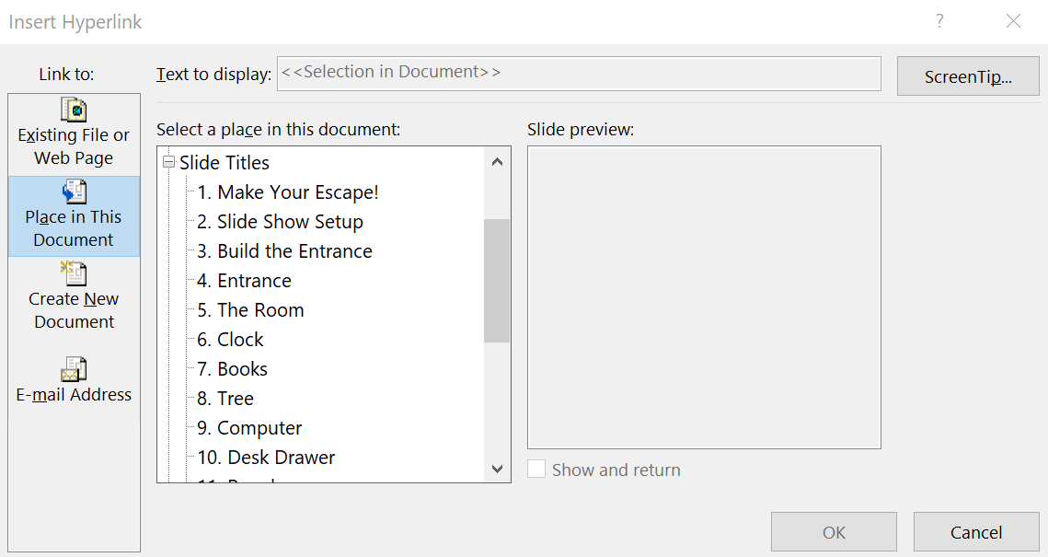
Build the Entrance
Introduce the story of your escape room on this page.
Add a picture or a button for the user to select to enter into your room.
Create a slide to be your room and then link your button to the slide.
Right click on the image or shape
Select Link->Insert Link
Select “Place in This Document”
Select the slide to go to.
Note: It helps if you add meaningful titles to your slides to help you with your links.

Slide 4
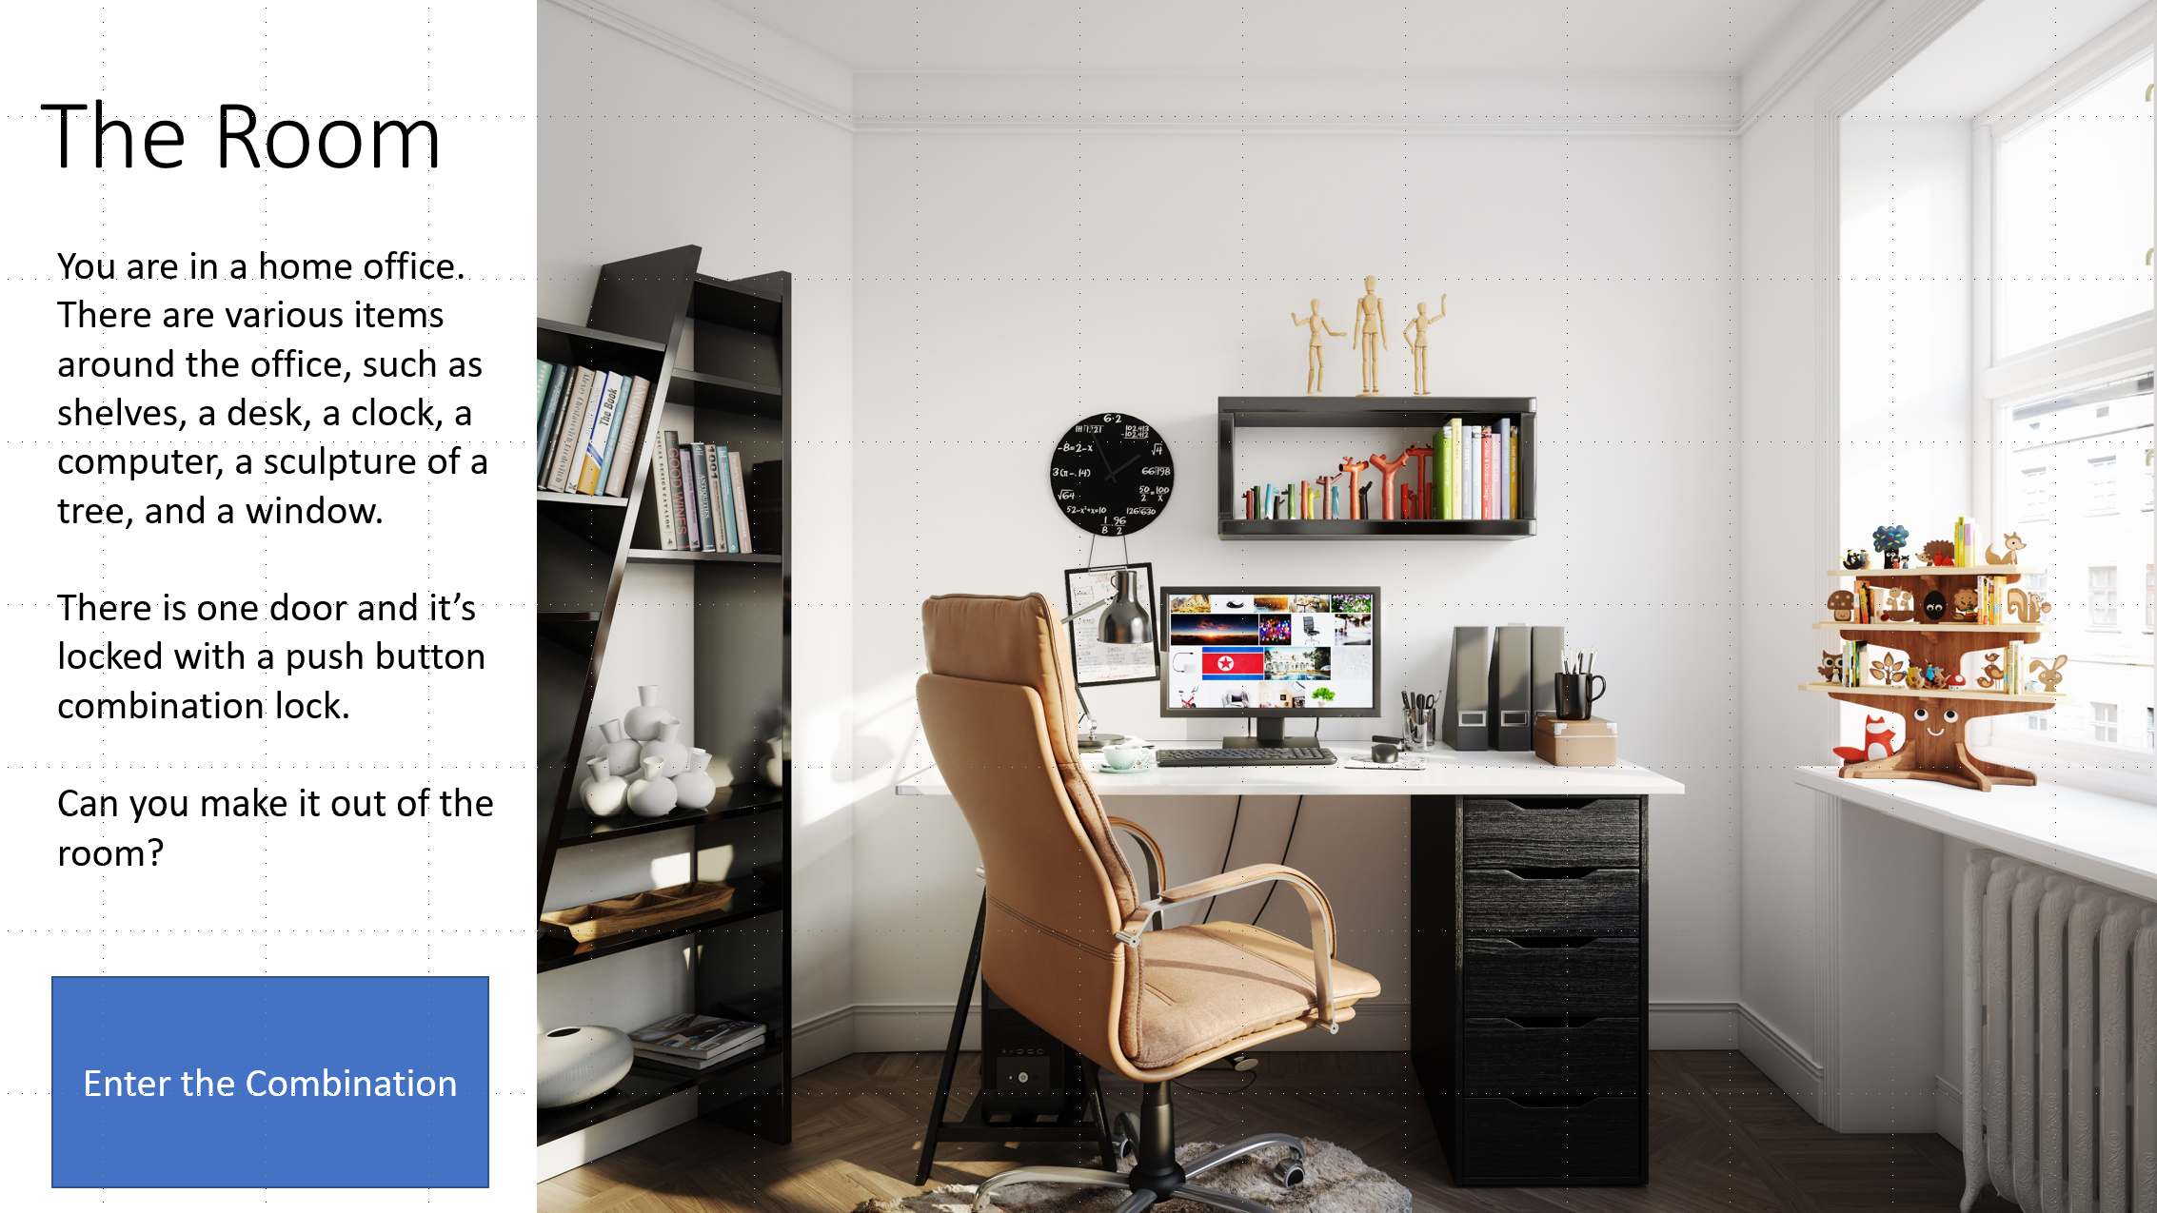
Build the Main Room
Create your room.
You can use an image or build your own with shapes.
Describe the room and/or objective.
A good description is necessary if you are making a 508 compliant room.
Decide what things in your room will be clues and which ones will be false clues.
Books
Computer
Tree
Clock
Drawer (false)
Wooden People (false)
Pots (false)
Scissors (false)
Make a page for each
You can title these using View->Outline View
Make a shape or add an image of the lock.

Slide 5
Make Links for Clues
Create a shape where you want the player to click.
Set the link for the shape as was done for the entrance.
Right click.
Link->Insert Link.
Place in this Document.
Select the slide.
Make the shape invisible.
Format Shape.
No fill.
No line.
For 508 compliance.
Right click.
Edit Alt Text and enter a description of the item.
Repeat for all the other clues.

Slide 6
The Room
You are in a home office. There are various items around the office, such as shelves, a desk, a clock, a computer, a sculpture of a tree, and a window.
There is one door and it’s locked with a push button combination lock.
Can you make it out of the room?
Enter the Combination

Slide 7
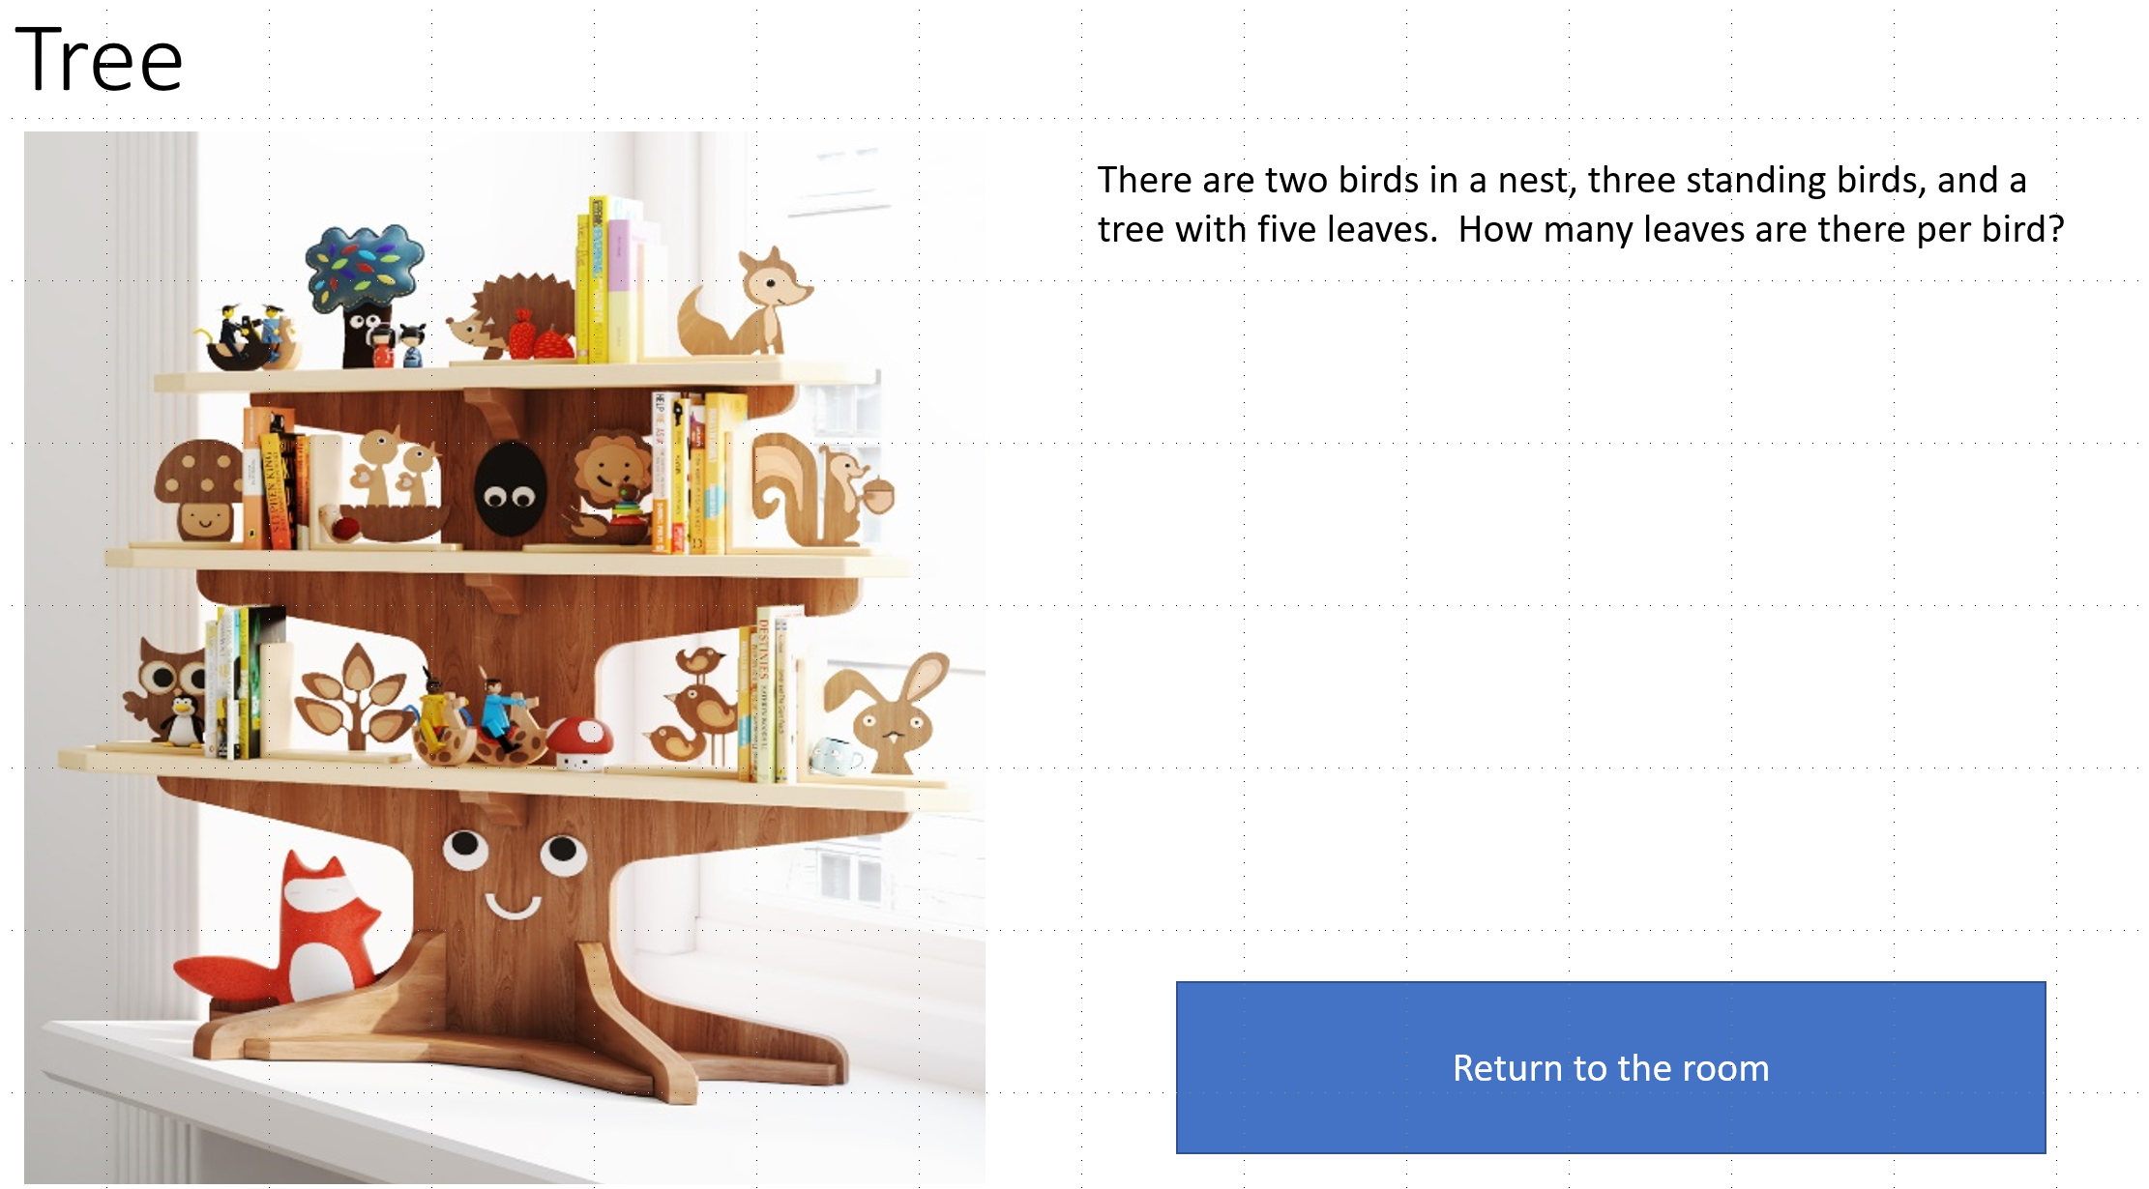
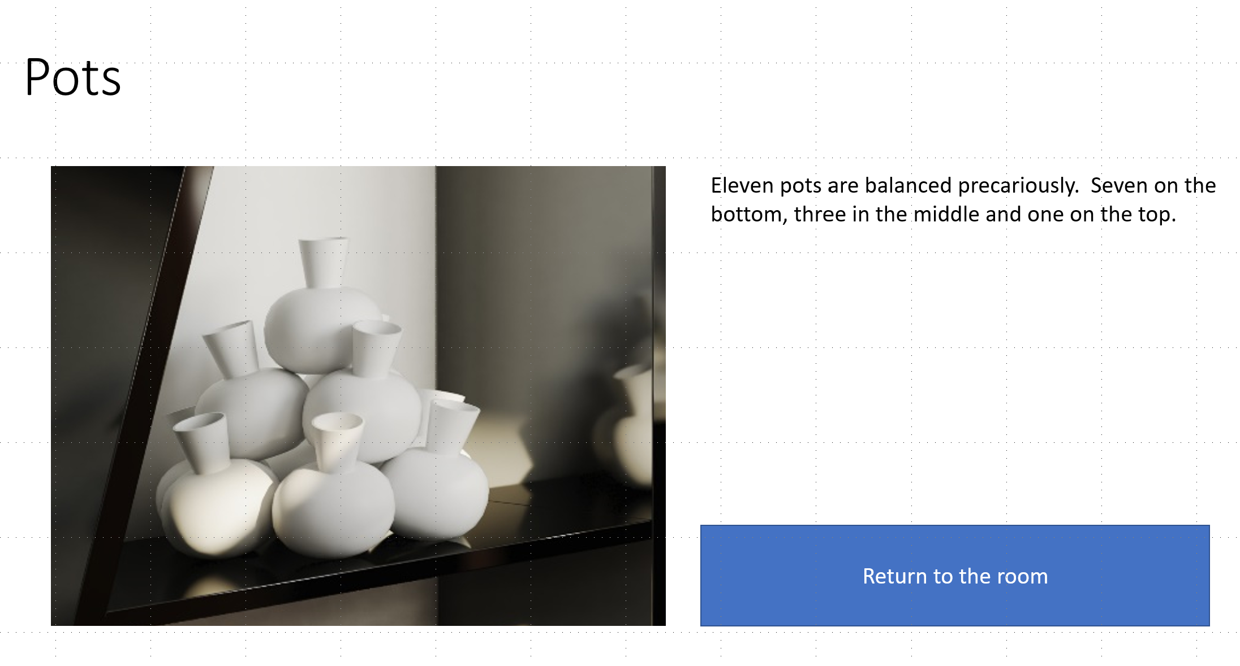
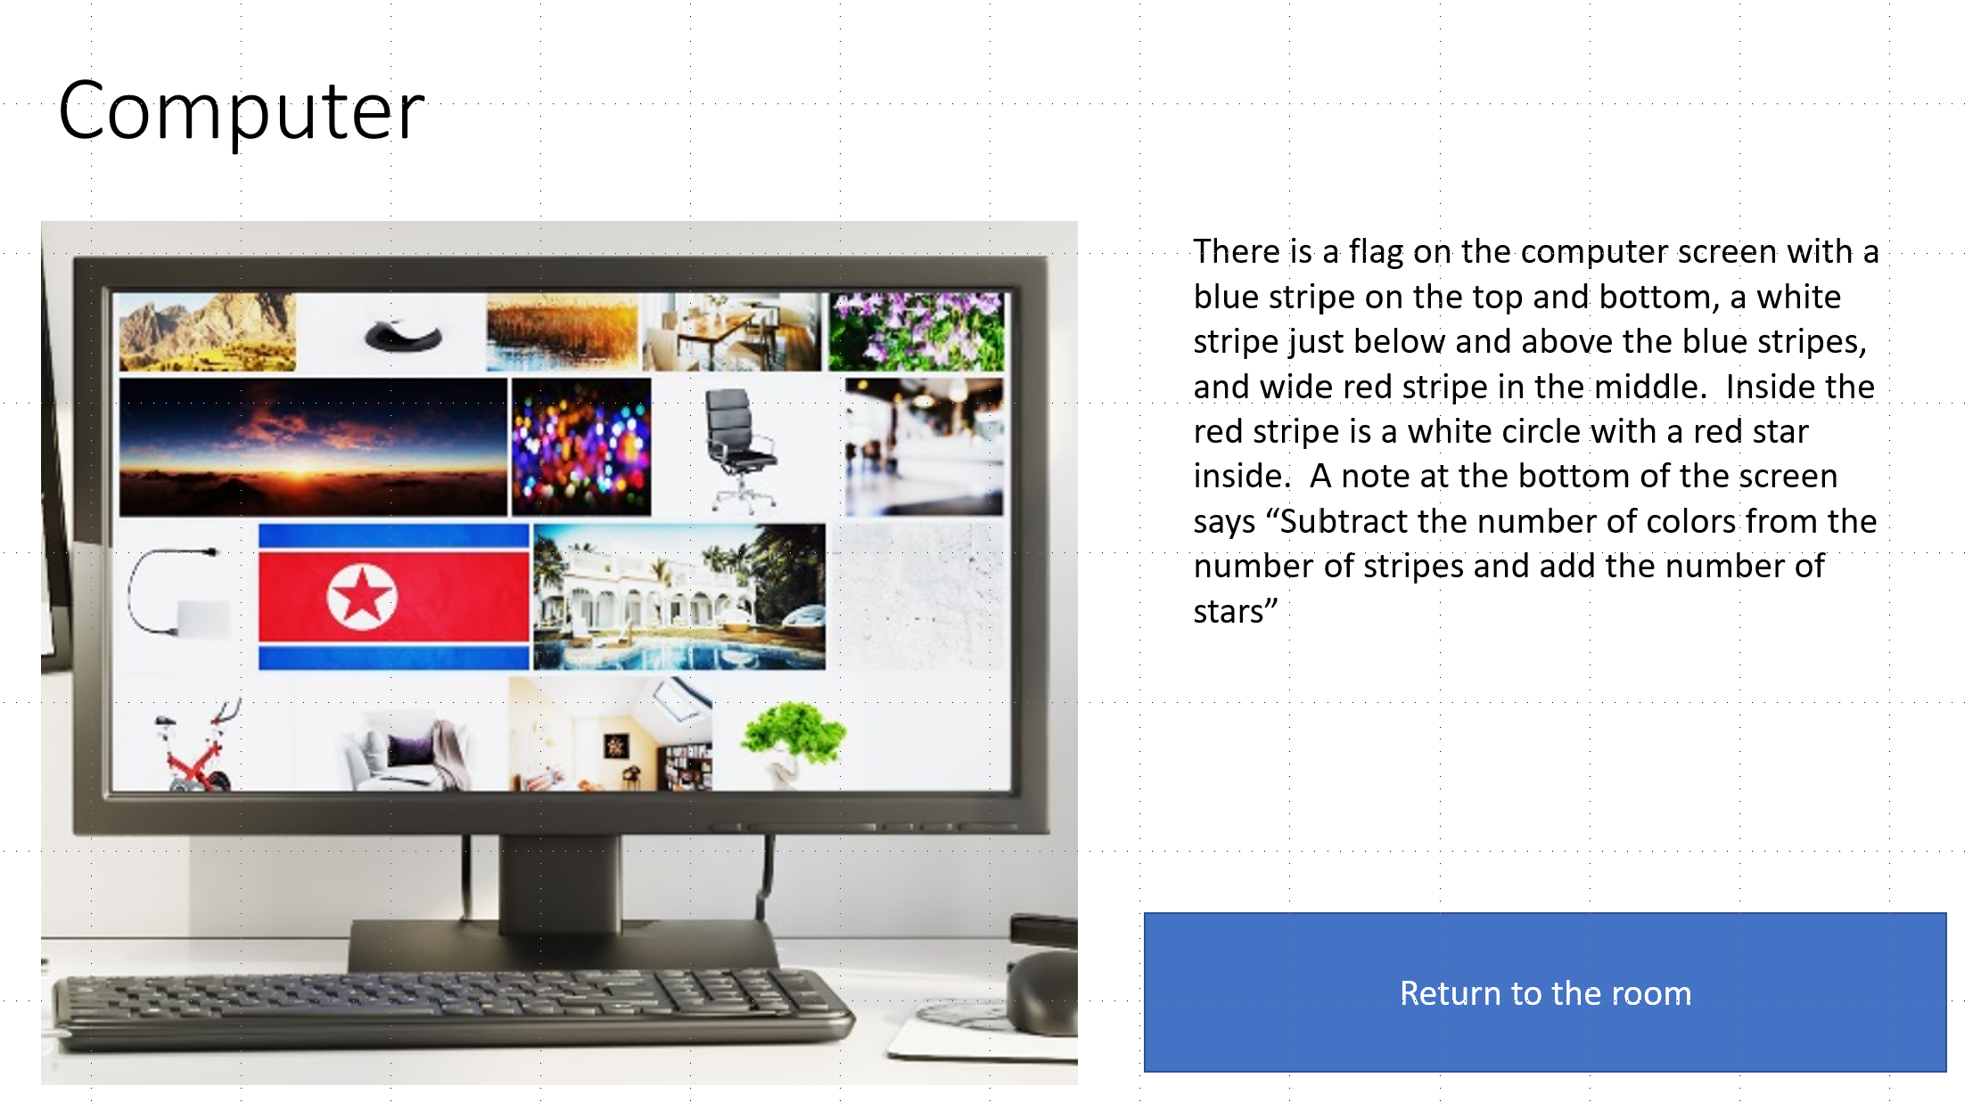
Make Clue Pages
Describe the clue.
Copy the room image and paste it.
Crop and describe.
Write out the clue.
Combine both.
Be creative.
Add a button to return to the room.

Slide 8
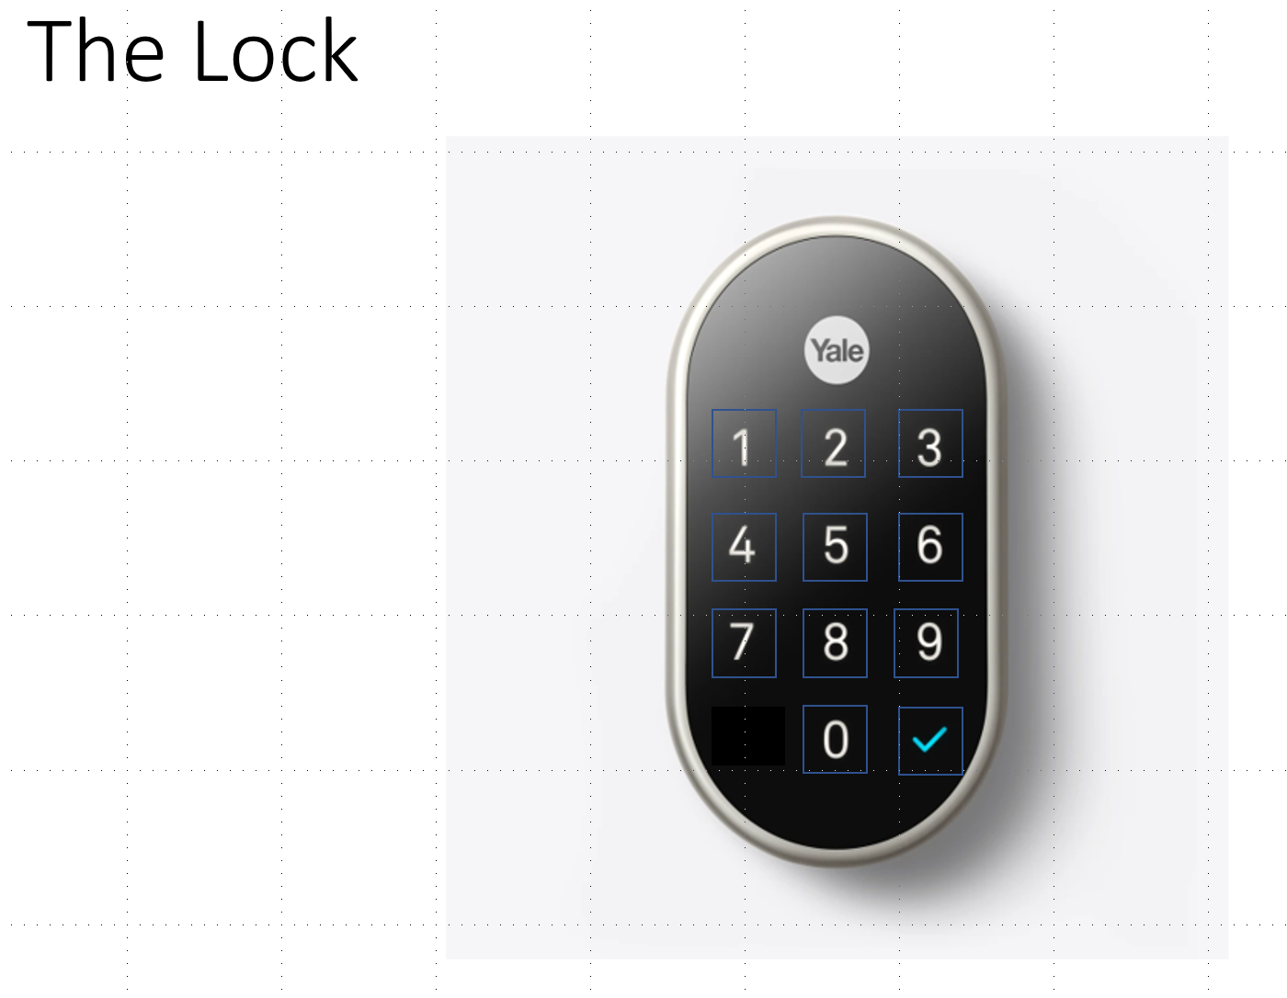
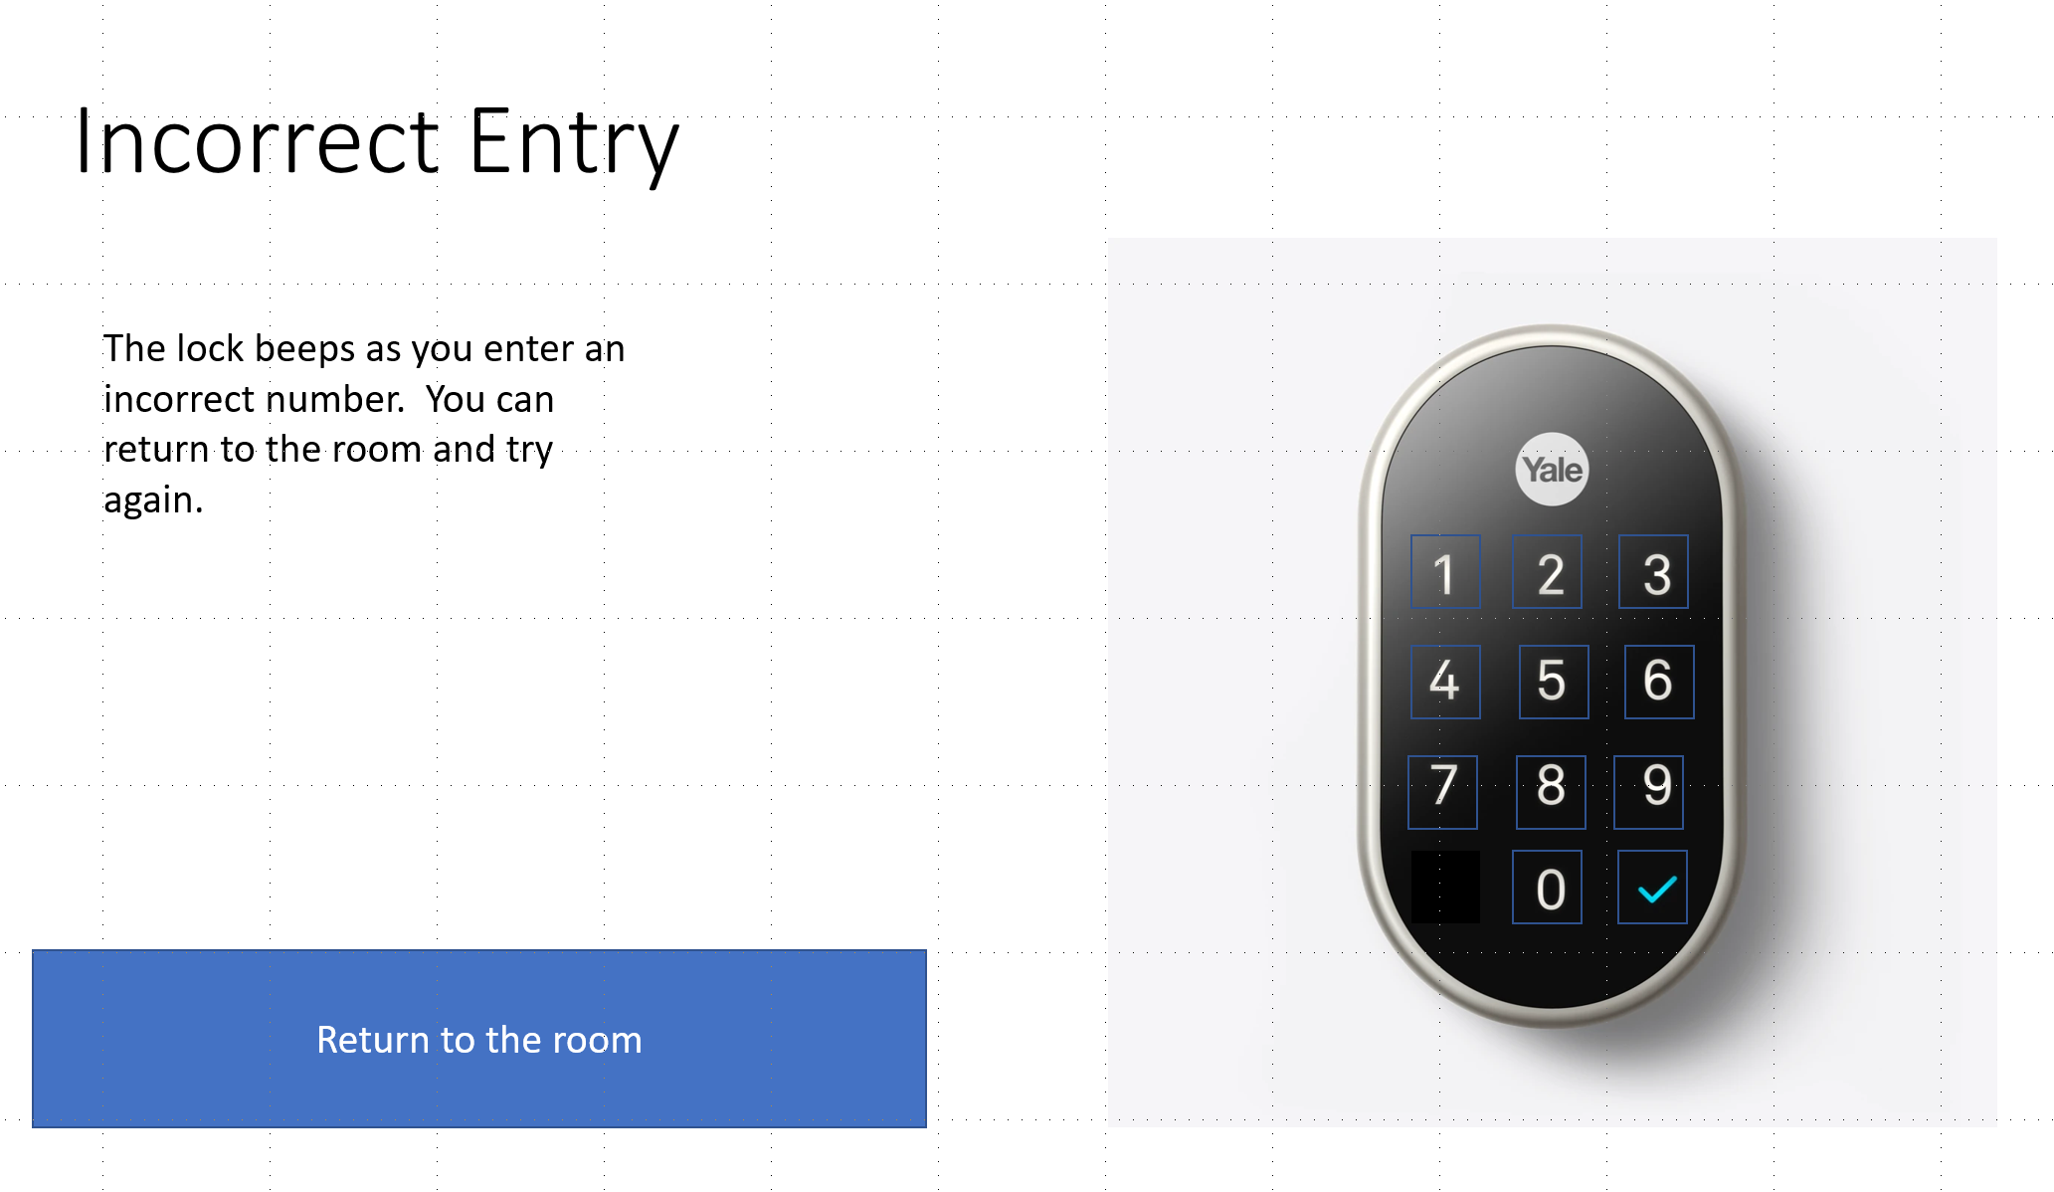
Make the Lock
For this you’ll be making a lot of duplicates so first make a base lock slide.
Put the picture of the lock on the background.
Format Background, picture, adjust as necessary.
Copy the slide to make an Incorrect Entry slide.
This is the slide you link to on a bad number input.
Add a “return to room” button and link it to the room.
Return to the base lock slide and make shapes for each number.
Link all number shapes to the “Incorrect Entry” page.
Duplicate the base lock page once for each combination number.
For our example there are four numbers and the enter key.
Create a final “You Escaped!” slide.

Slide 9
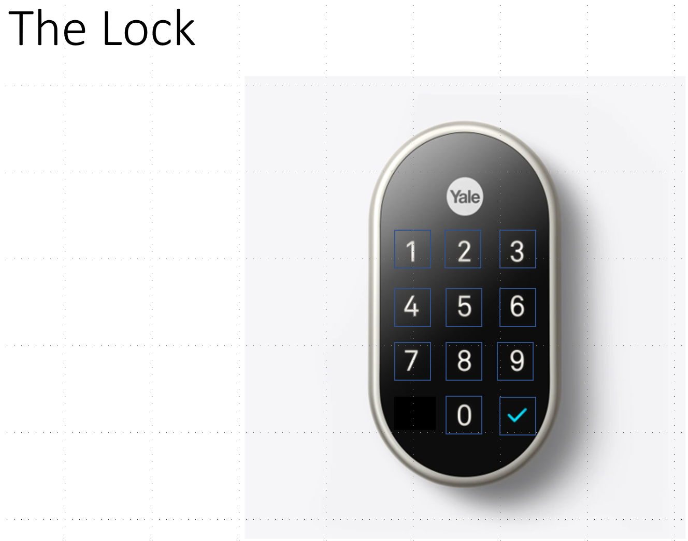
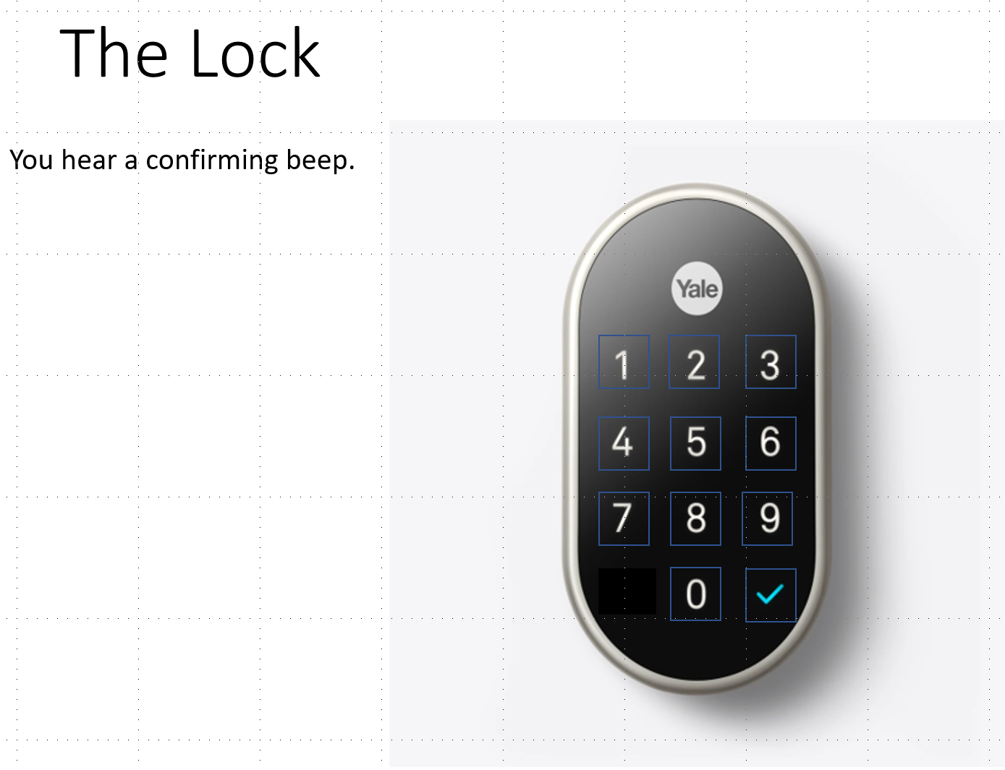
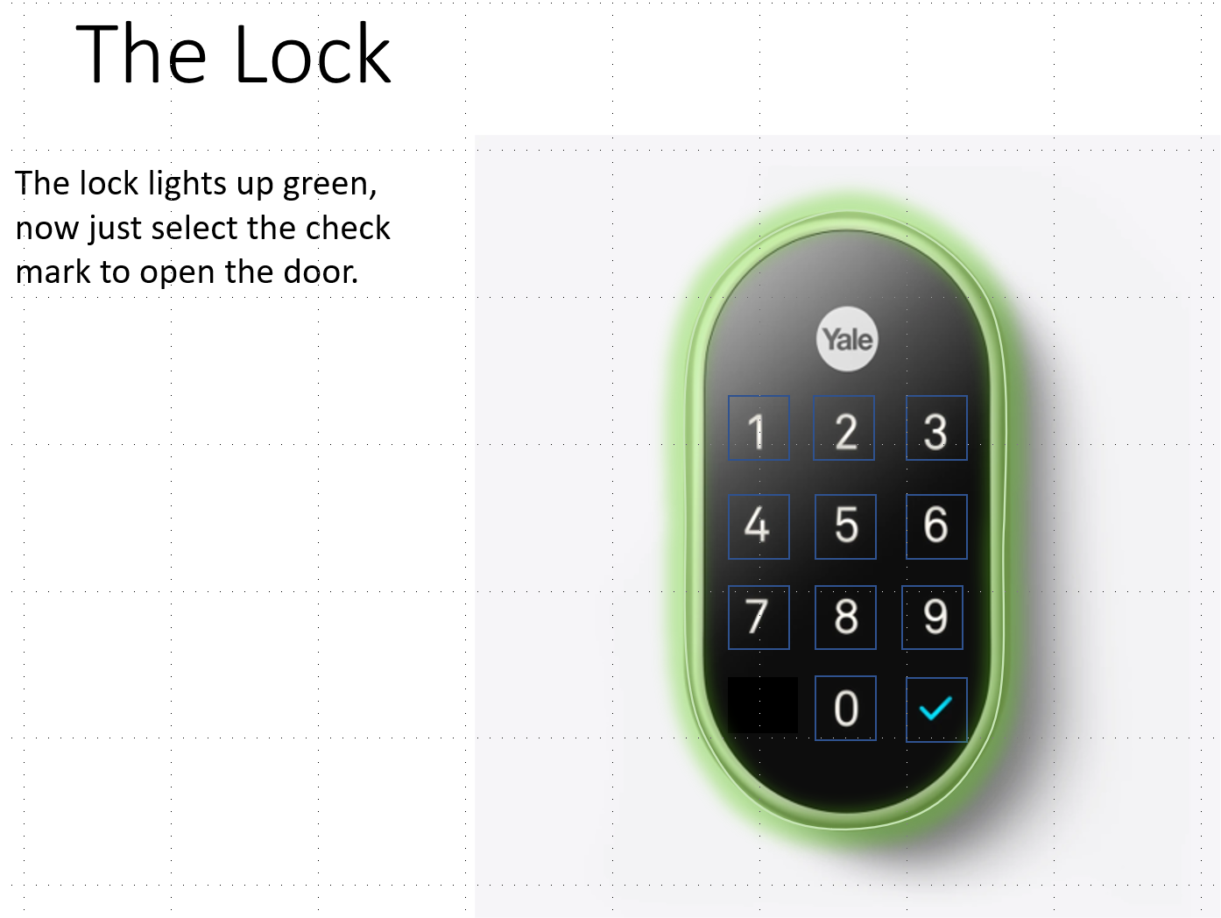
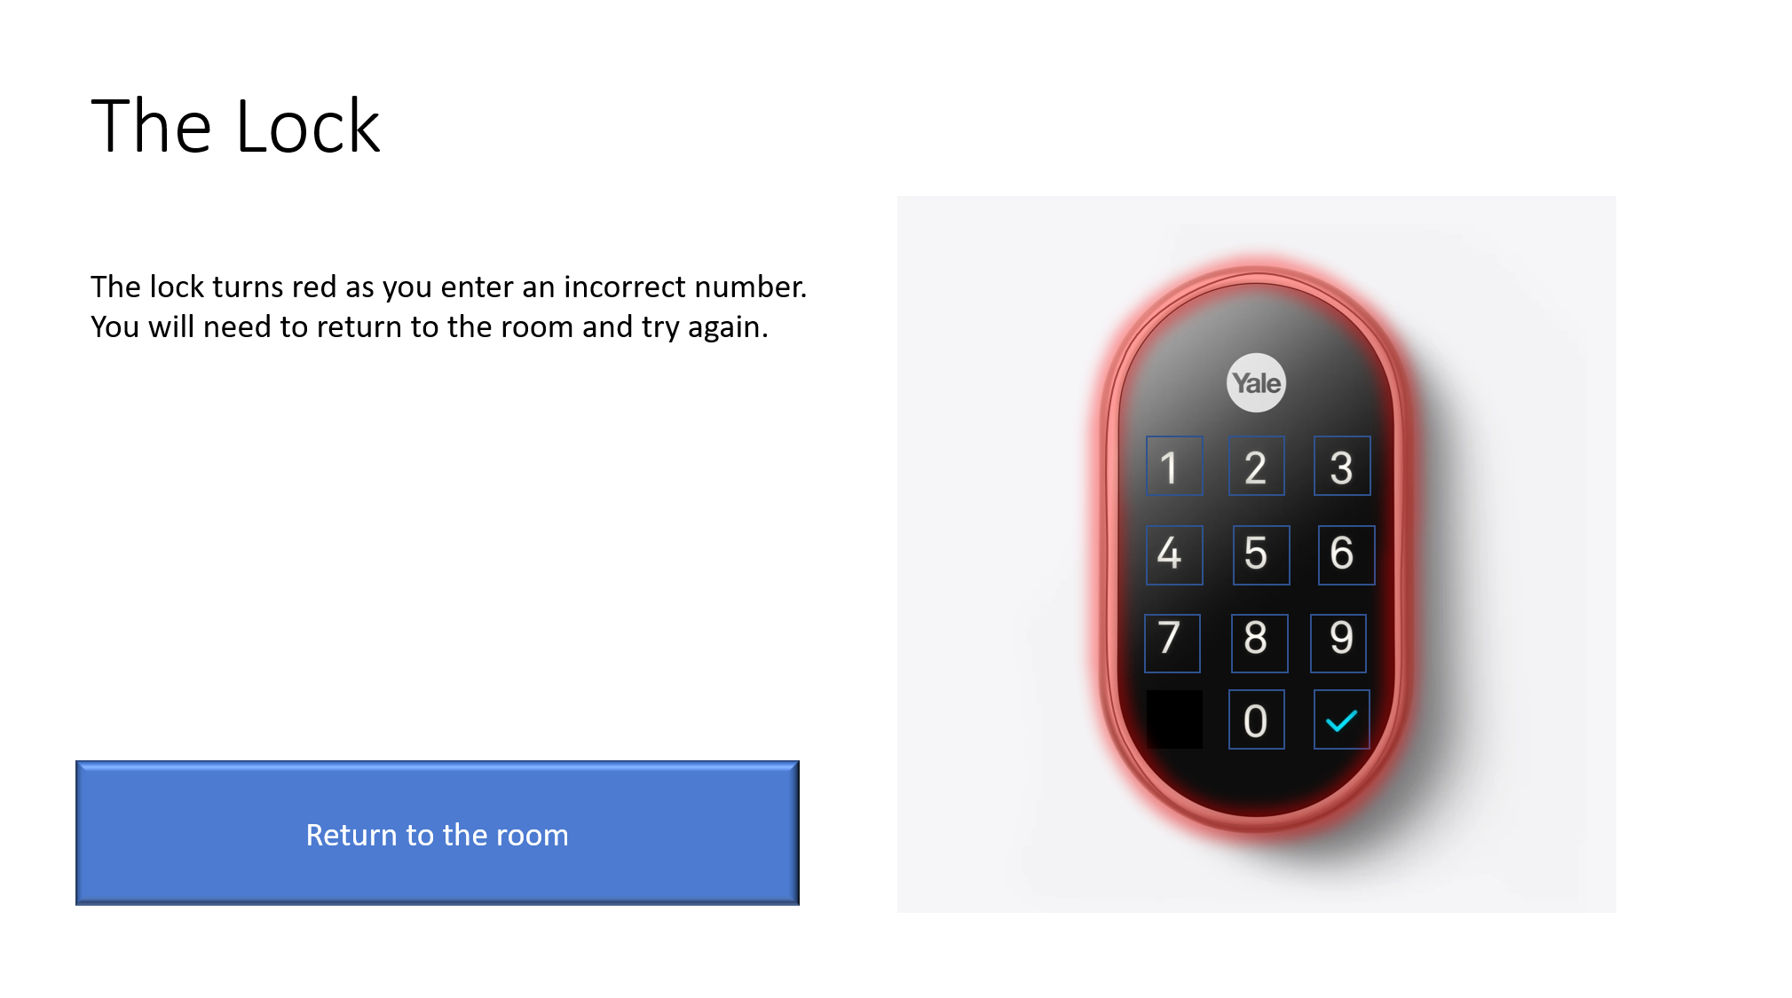
Set the Combination
Link the first correct number to the next lock page.
Change the description on the page to indicate that a correct number was pressed.
Continue for the rest of the combination numbers.
Link the last number or entry key to the final slide.

Slide 10
Test and Build
Run through your room in Slide Show.
Test the wrong combinations as well as the correct ones to make sure the links are correct.
Once the Slide Show works, you can save it as a Power Point Presentation and deliver it.
Expand it!
Add multiple rooms.
Each room can be a different lesson.
Imagine each escape room as a test for a different subject.
Add multiple locks which reveal other clues.
Locks can be answers to multiple choice questions.
Weave in story with lessons.

