Slide 1
Escape Room Template and files
The following pages contain the images and pages used in the sample escape room without the descriptions and puzzles. Feel free to use this to practice or customize for your own use.

Slide 2

Entrance
Welcome to an example escape room built in Power Point. This is where you would introduce the story behind why the learner is going to be in the room and what they should expect. This could be something as simple as “You will need to solve math problems to escape the room” to a complete story of how you’re going into your boss’s office to find clues as to why they’ve disappeared.
This panel is linked to the room slide. You can remove the text or change it to let the player know they need to click here.

Slide 3
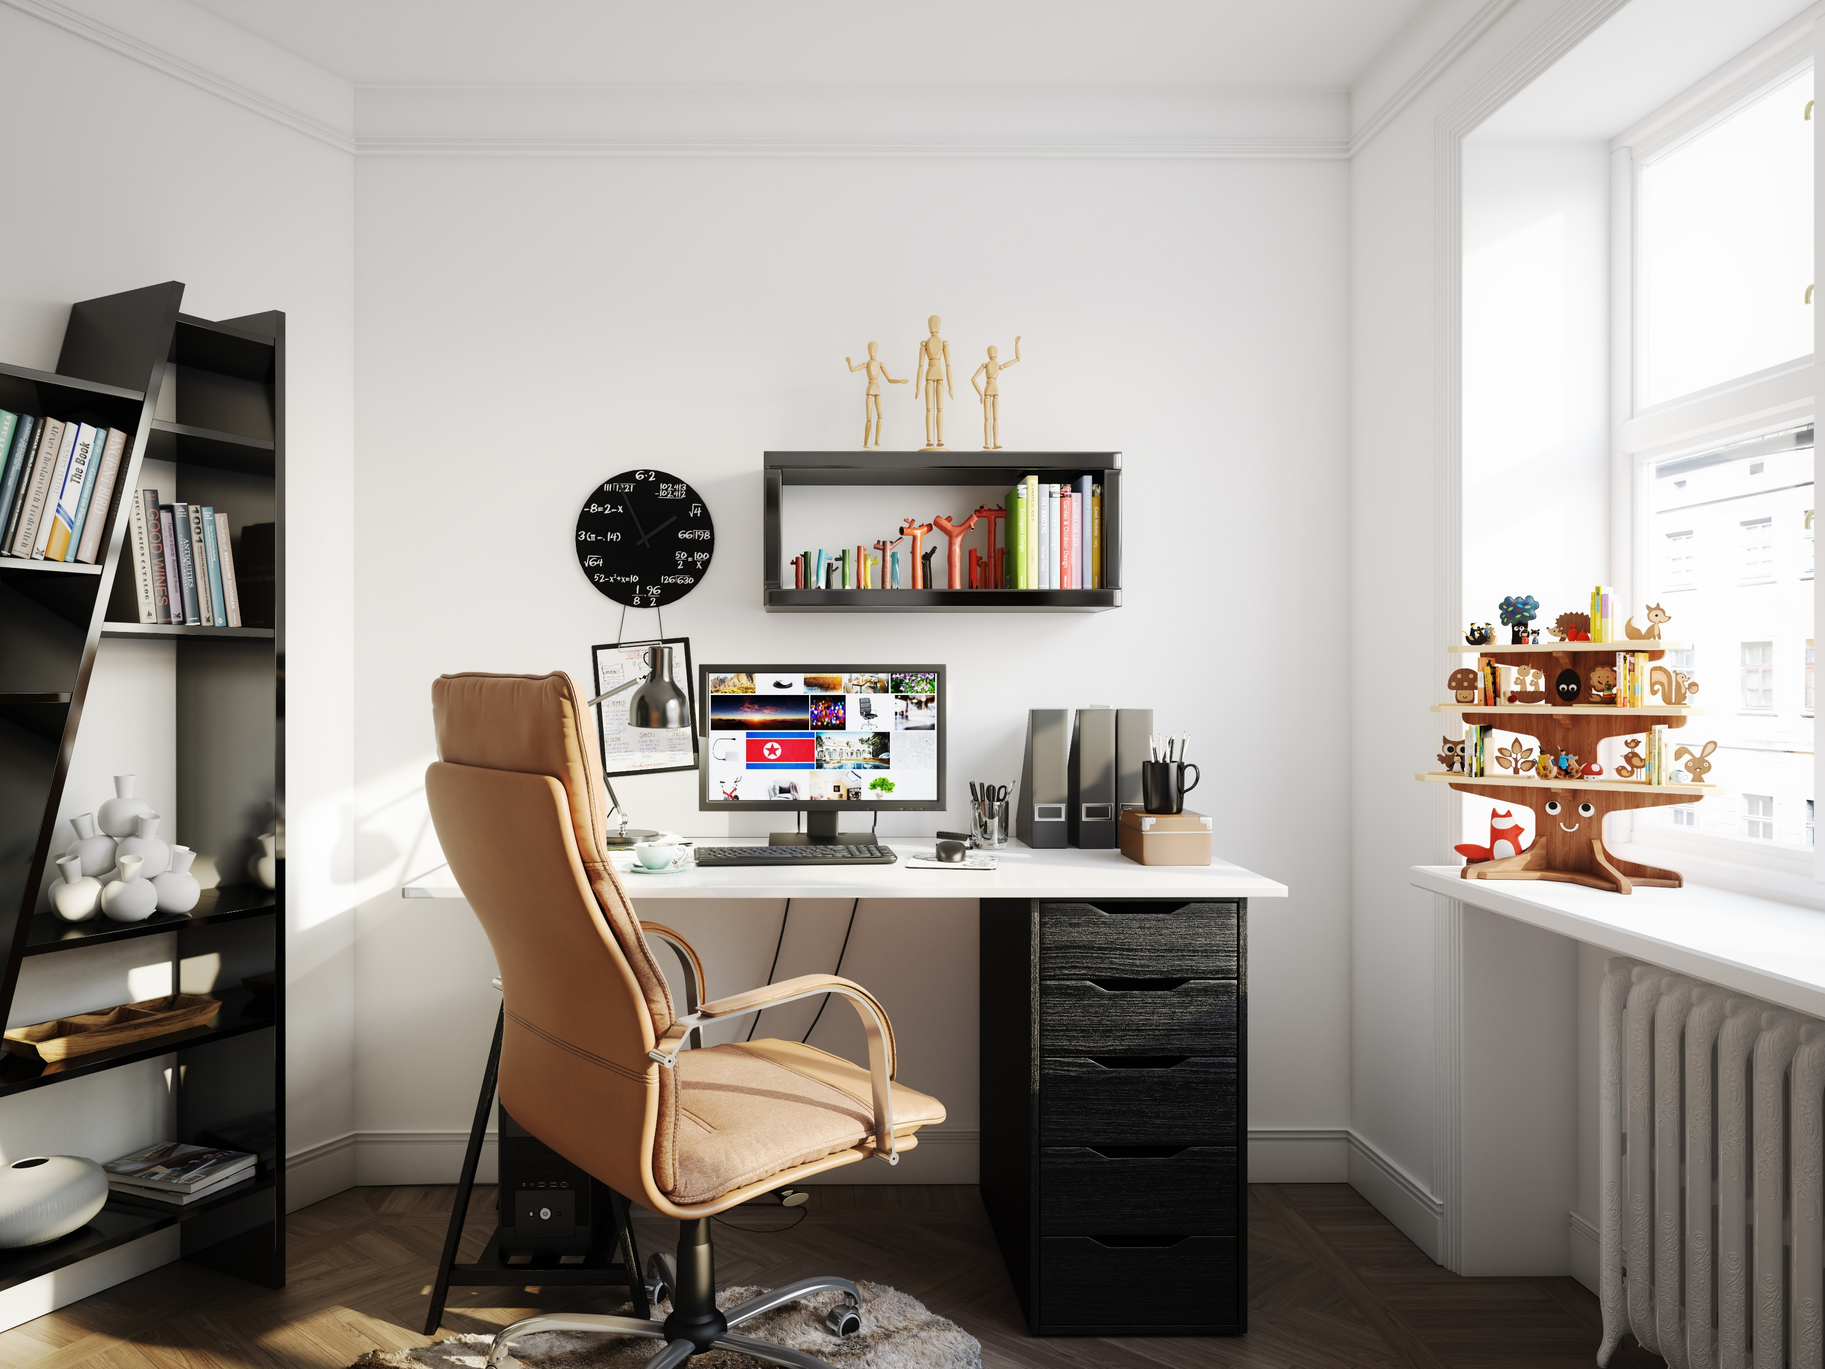
The Room
You can put a description of the room here, or text describing the scenario if you wish. Or, if you want, you can remove the text and let the player explore. Seven things are linked to other pages. They are outlined in yellow. You should remove the outline if you want your players to have to find the clickable items.
This button is linked to the lock. Change text as you wish.

Slide 4
Clock
Add any puzzle text here. You can use the image as a clue, but if you’re making your room 508 compliant, make sure that there is text that describes the image to your player.
Return to the room

Slide 5
Books
Add any puzzle text here. You can use the image as a clue, but if you’re making your room 508 compliant, make sure that there is text that describes the image to your player.
Return to the room

Slide 6
Tree
Add any puzzle text here. You can use the image as a clue, but if you’re making your room 508 compliant, make sure that there is text that describes the image to your player.
Return to the room

Slide 7
Computer
Add any puzzle text here. You can use the image as a clue, but if you’re making your room 508 compliant, make sure that there is text that describes the image to your player.
Return to the room

Slide 8
Desk Drawer
Add any puzzle text here. You can use the image as a clue, but if you’re making your room 508 compliant, make sure that there is text that describes the image to your player.
Return to the room

Slide 9
People
Add any puzzle text here. You can use the image as a clue, but if you’re making your room 508 compliant, make sure that there is text that describes the image to your player.
Return to the room

Slide 10
Pots
Add any puzzle text here. You can use the image as a clue, but if you’re making your room 508 compliant, make sure that there is text that describes the image to your player.
Return to the room

Slide 11
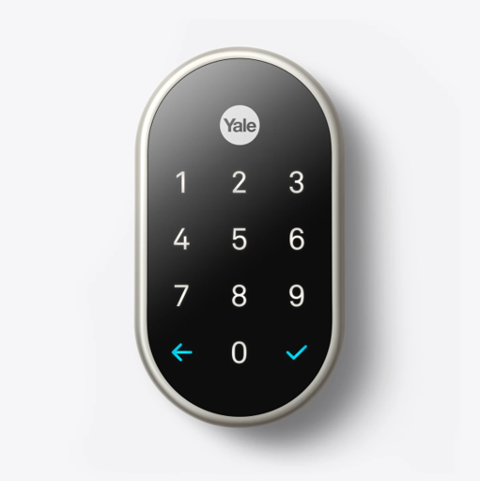
The Lock
This is the first page of a four digit number lock. Currently all of the numbers are linked to the incorrect entry slide. You will need to select the first number of the combination and link it to slide 12.

Slide 12
The Lock
This is the second page of a four digit number lock. Currently all of the numbers are linked to the incorrect entry slide. You will need to select the second number of the combination and link it to slide 13. You should replace this text to let the player know that they entered a correct number.

Slide 13
The Lock
This is the third page of a four digit number lock. Currently all of the numbers are linked to the incorrect entry slide. You will need to select the third number of the combination and link it to slide 14. You should replace this text to let the player know that they entered a correct number.

Slide 14
The Lock
This is the forth page of a four digit number lock. Currently all of the numbers are linked to the incorrect entry slide. You will need to select the fourth number of the combination and link it to slide 15. You should replace this text to let the player know that they entered a correct number.

Slide 15
The Lock
This is the slide which shows the player they entered the correct code. Now all they need to do is select the check mark to exit the room. The text here should be changed to reflect that.

Slide 16

The Lock
The lock turns red as you enter an incorrect number. You will need to return to the room and try again.
Return to the room

Slide 17




This is the success page, decorate how you wish.

